Slide 1
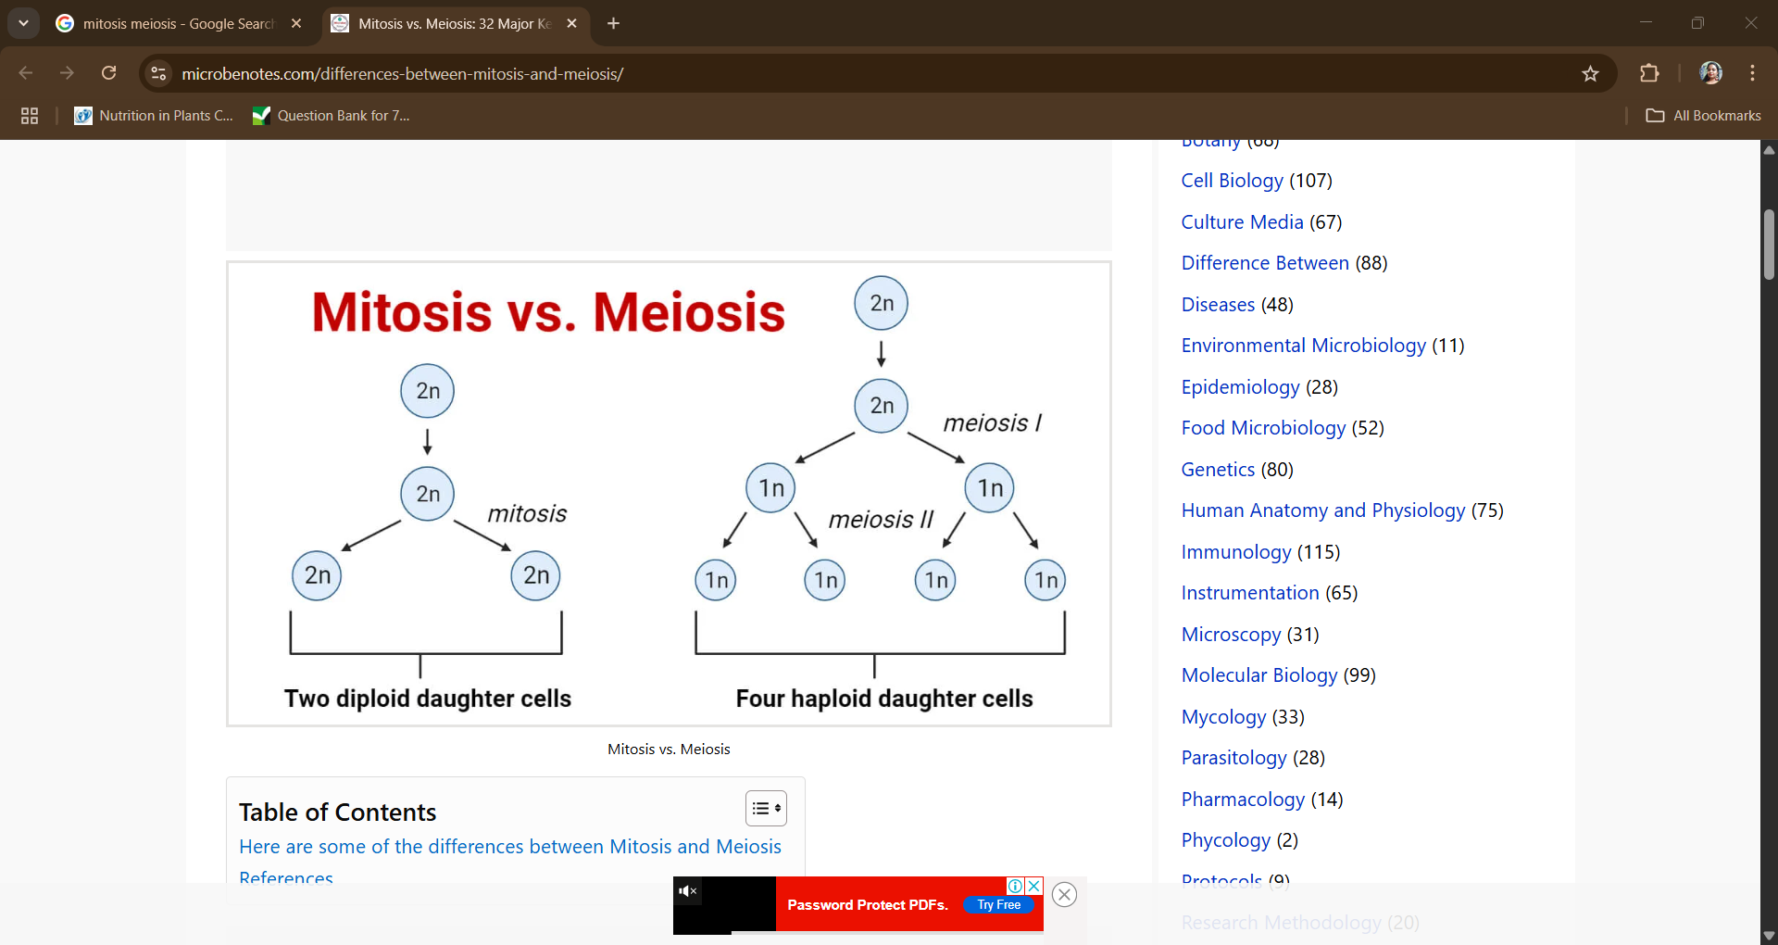
BIOLOGY STUDY MATERIALS
CLASS VIII
REPRODUCTION IN ANGIOSPERMS
CELL DIVISION

Slide 2
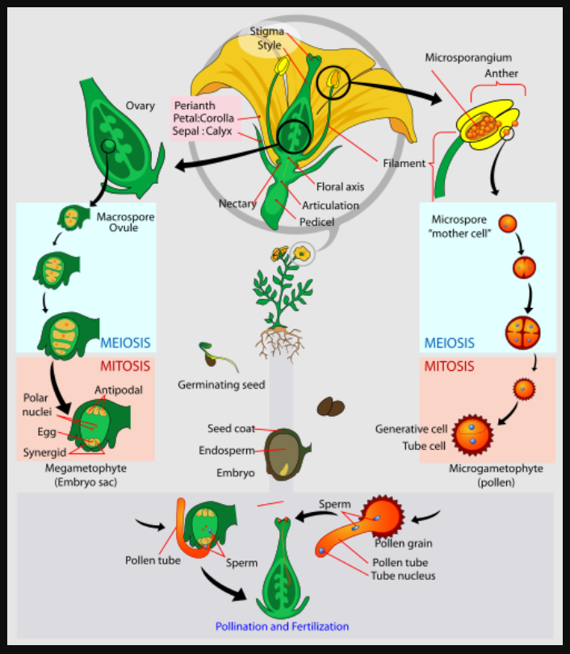
MEGASPOROGENESIS The process by which haploid megaspores are formed from diploid megaspore mother cells (MMCs) within the megasporangium.
MICROSPOROGENESIS
Formation of microspores from microspore mother cell by meiosis.
1. MMC develops within the pollen sac.
2. MMC undergoes meiosis to form 4 haploid microspores.
3. Each microspore undergoes mitosis to form immature pollen grain.

Slide 3
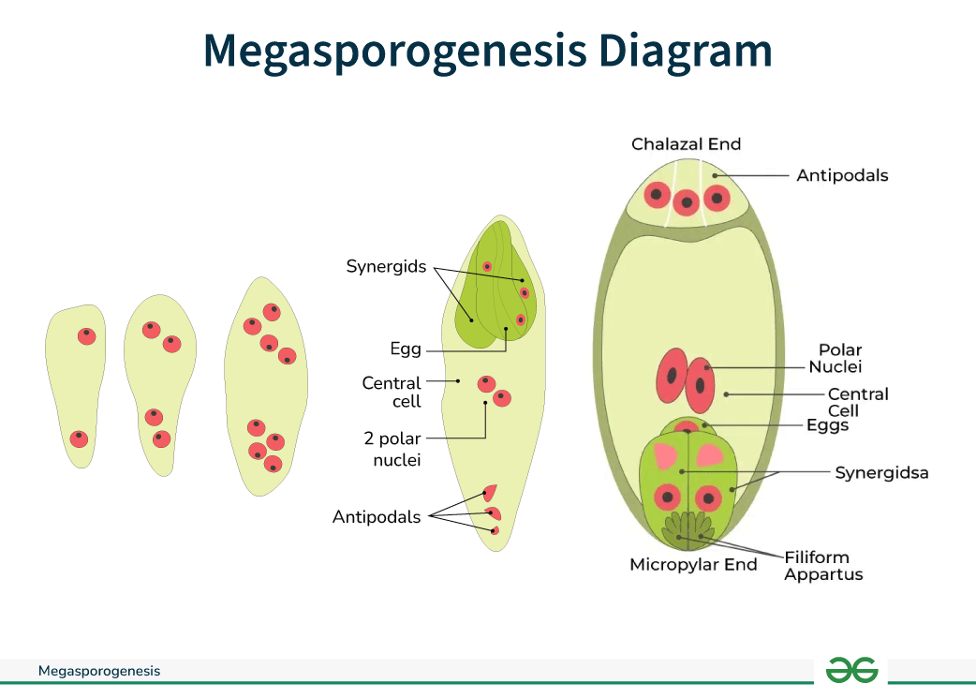

Slide 4
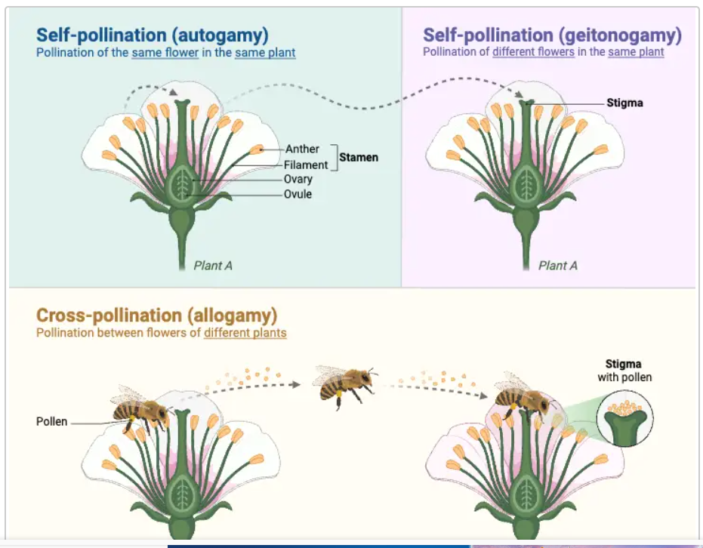
Xenogamy

Slide 5
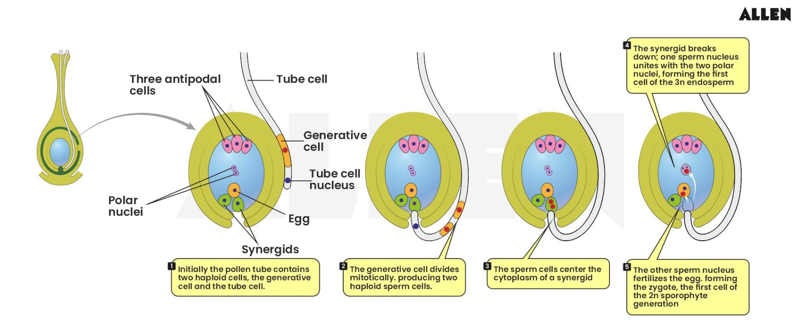
FERTILIZATION

